Slide 1
Capstone Project - The Battle of Neighborhoods

Slide 2
Introduction
New York City is the most populous city in the United States, with an estimated 2018 population of over 8 million.
The diverse culture leads to diverse food cuisines.
In this project, we will list and visualize all parts of NYC which has great Chinese restaurants.
The project can help visitors or newcomers to NYC to find their desired good Chinese restaurants. They can also decide which area of NYC they'd like to stay at for good Chinese food.

Slide 3
Data
New York City data that contains list Boroughs, Neighborhoods along with their latitude and longitude.
Data source : https://cocl.us/new_york_dataset
Description : This data set provides the location of various neighborhoods of new york city.
Chinese resturants in each neighborhood of new york city.
Data source : Fousquare API
Description : We will get all venues in each neighborhood and then filter them to get only Chinese restaurants.
GeoSpace data
Data source : https://data.cityofnewyork.us/City-Government/Borough-Boundaries/tqmj-j8zm
Description : New york Borough boundaries for better map visulization.

Slide 4
Methodology
Collect the new york city data from https://cocl.us/new_york_dataset
Using FourSquare API to gather all venues for each neighborhood.
Filter out all venues that are Chinese Resturants.
Find rating , tips and like count for each Chinese Resturants using FourSquare API.
Using rating for each resturant , we will sort that data.
Visualize the Ranking of neighborhoods using Python folium library.

Slide 5

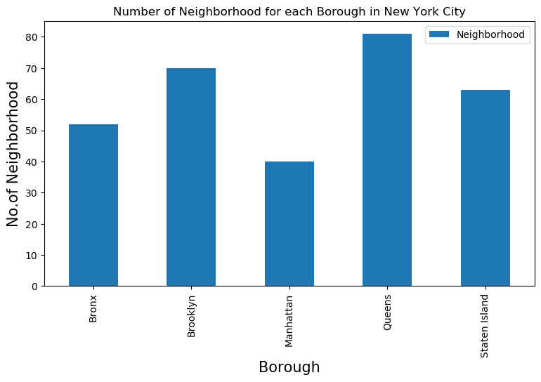
Number Of Neighborhood For Each Borough In New York City

Slide 6
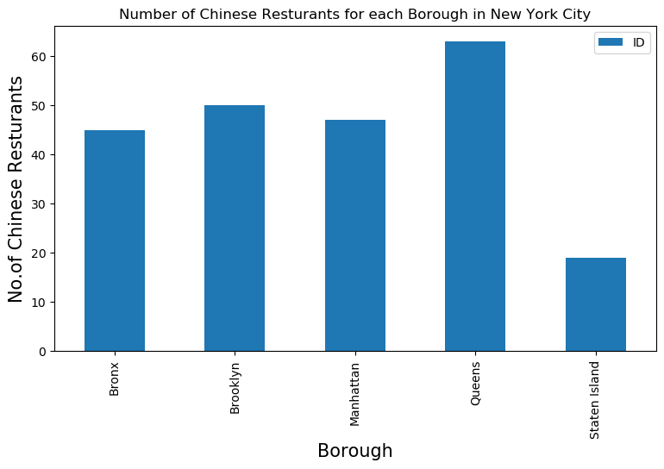
Number Of Chinese Restaurants For Each Borough In New York City

Slide 7
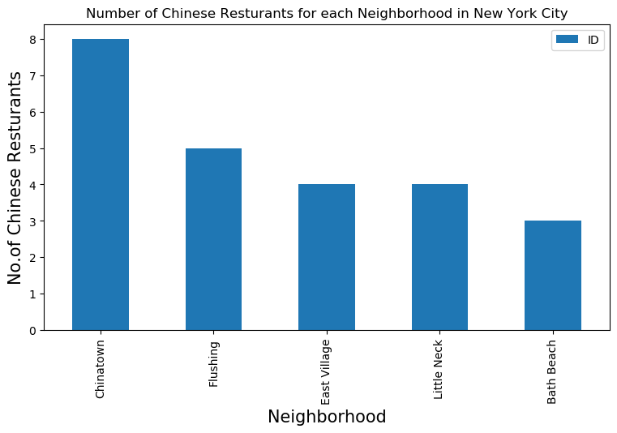
Number Of Chinese Restaurants For Each Neighborhood In New York City

Slide 8
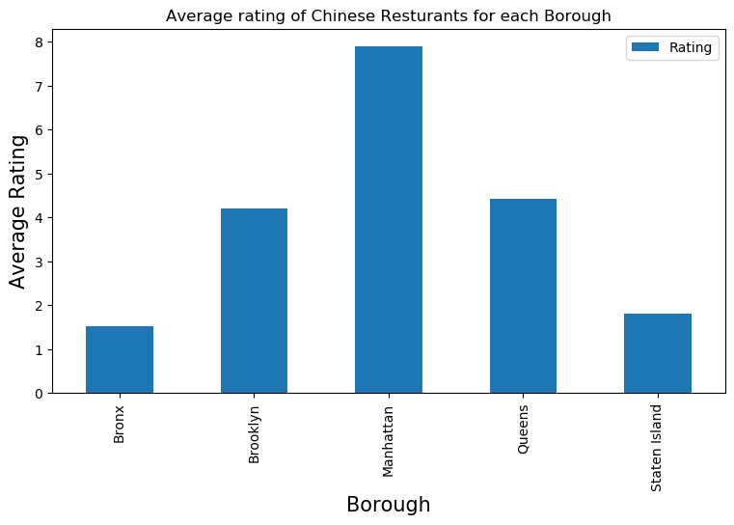
Average Rating Of Chinese Resturants For Each Borough

Slide 9
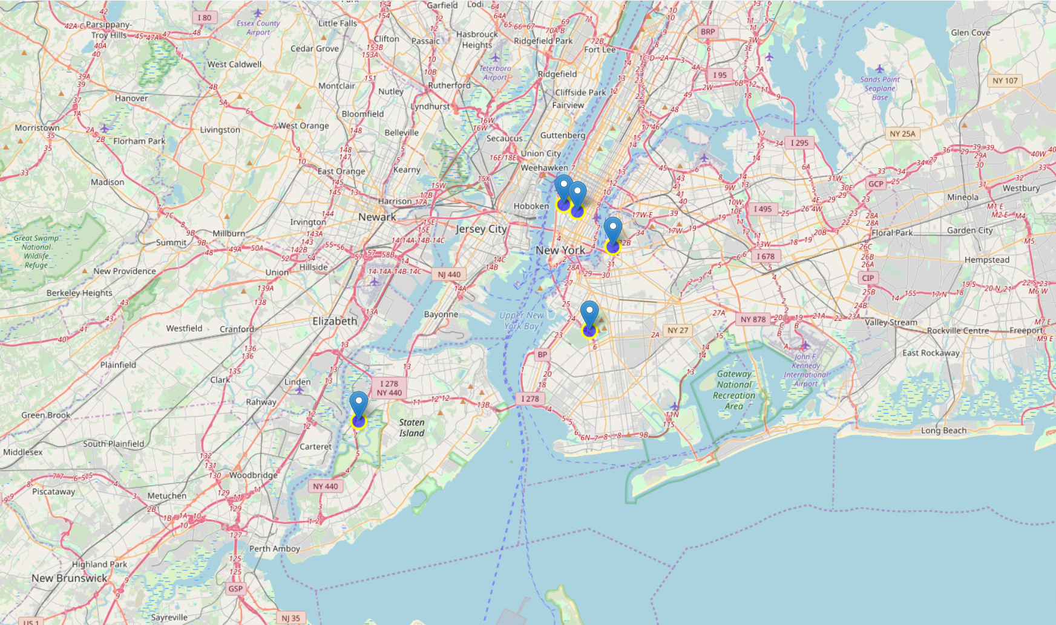
Top 5 Neighborhoods for Chinese Food

Slide 10
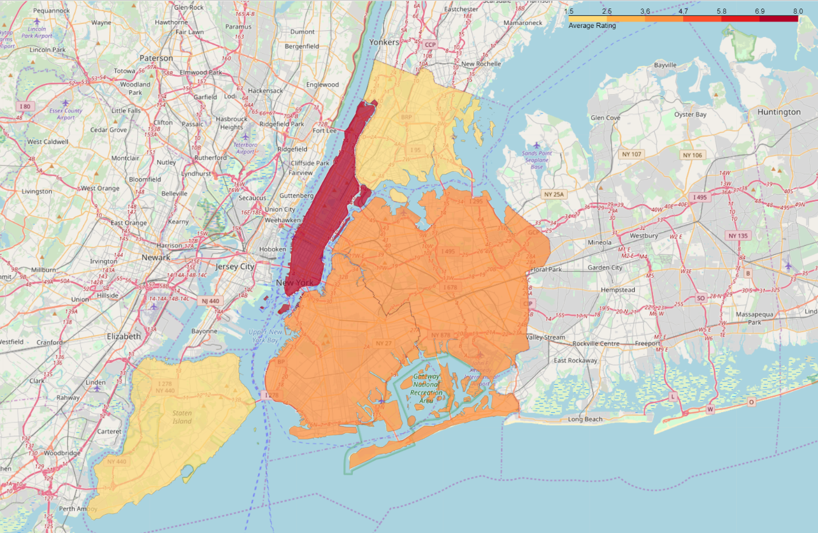
Average Ratings of all Boroughs

Slide 11
Results
Chelsea(Manhattan), North Side(Brooklyn), Flatiron(Manhattan) are some of the best neighborhoods for Chinese cuisine.
Even though Chelsea(Staten Island) has a very high average rating, since the Chinese restaurant in Staten Island is very few, this place may not be considered as a good place for Chinese food.
Staten Island ranks last in average rating of Chinese Resturants.
Manhattan, Queens & Brooklyn are all good places for Chinese food. Overall Manhattan has a good balance between restaurant numbers and ratings.

Slide 12
Conclusion
In this project we studied the Chinese restaurants in New York City and try to determine which neighborhood is good for having some good Chinese food. We use new york city data and FourSquare API to gather all venues, filtering out Chinese restaurants and then sort the data base on their ratings. Finally we do the data visualization of the average Chinese restaurant ratings for every neighborhoods in New York.

